Slide 1
Chapter 18
How to build a GUI program

Slide 2
Objectives
Applied
Develop a GUI program that has a user interface that consists of frames, buttons, labels, and text entry fields in a grid format.
Knowledge
Describe the need for the mainloop() method of a tkinter root window in terms of the event processing loop.
Describe the way an event handler works with a GUI component like a button.
Describe how the grid() method is used to lay out the components in a frame.
Describe the reason for creating a subclass of the ttk.Frame class when you’re building a GUI.

Slide 3
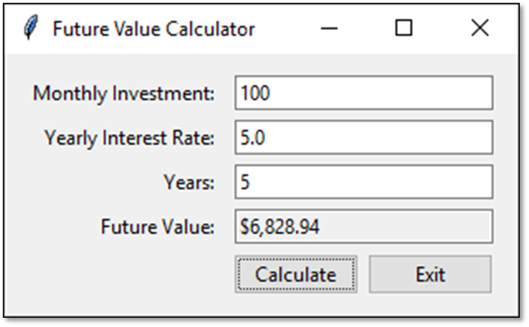
A window with ten components

Slide 4
The constructor of the root window
Tk()
The methods of the root window
title(title)
geometry(str)
mainloop()

Slide 5
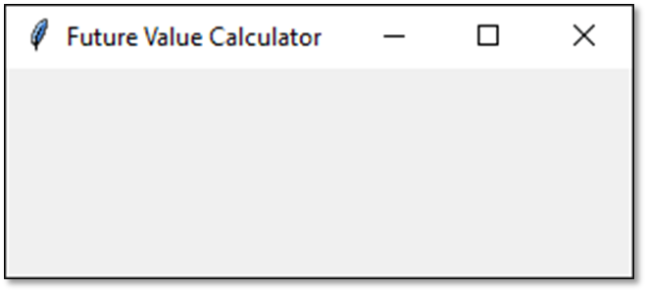
How to import the tkinter module
import tkinter as tk
How to create an empty root window
root = tk.Tk()
root.title("Future Value Calculator")
root.geometry("300x200")
How to make the root window visible
root.mainloop()
An empty root window

Slide 6
Two constructors of the ttk module
Frame(parent[, padding])
Button(parent, text)
A method for working with all components
pack([fill][, expand])

Slide 7
How to import the ttk module
from tkinter import ttk
How to add a frame to the root window
frame = ttk.Frame(root, padding="10 10 10 10")
frame.pack(fill=tk.BOTH, expand=True)

Slide 8
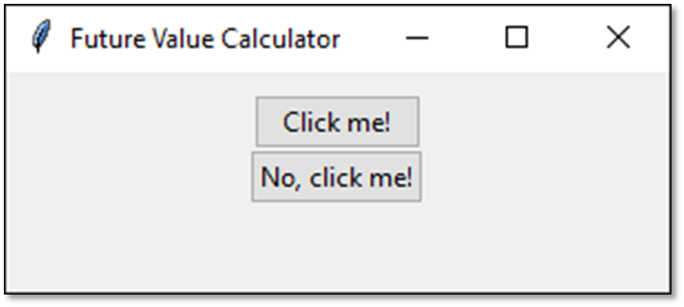
How to add two buttons to the frame
button1 = ttk.Button(frame, text="Click me!")
button2 = ttk.Button(frame, text="No, click me!")
How to display the buttons
button1.pack()
button2.pack()
Two buttons in a frame

Slide 9
An argument of the Button constructor
command
The destroy() method of the root window
destroy()

Slide 10
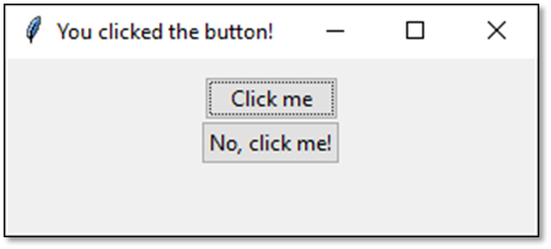
How to connect two buttons to callback functions
button1 = ttk.Button(frame, text="Click me",
command=click_button1)
button2 = ttk.Button(frame, text="No, click me!",
command=click_button2)
The callback functions
def click_button1():
root.title("You clicked the button!")
def click_button2():
root.destroy()
The GUI after the user clicks the first button

Slide 11
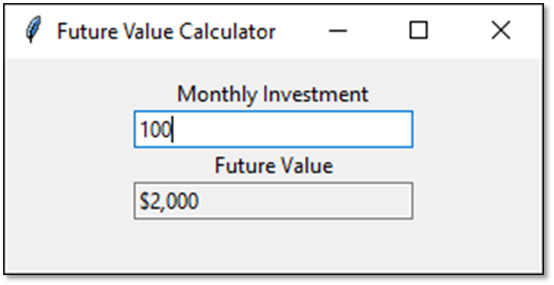
A window with labels and text entry fields

Slide 12
Constructors for labels and text entry fields
Label(parent, text)
Entry(parent, width, textvariable[, state])

Slide 13
How to create a label and display it
investmentLabel = ttk.Label(frame,
text="Monthly Investment")
investmentLabel.pack()
Another way to create a label and display it
ttk.Label(frame, text="Monthly Investment").pack()

Slide 14
Constructors and methods of the StringVar class
StringVar()
get()
set(str)

Slide 15
How to bind a text entry field to a StringVar object
investmentText = tk.StringVar()
investmentEntry = ttk.Entry(frame, width=25,
textvariable=investmentText)
How to create a read-only text entry field
fvText = tk.StringVar()
fvEntry = ttk.Entry(frame, width=25, textvariable=fvText,
state="readonly")
How to get or set a string in a text entry field
investment = investmentText.get()
fvText.set("$2,000")

Slide 16
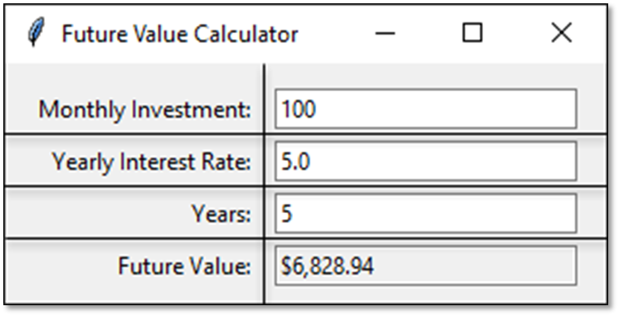
Eight components in a grid

Slide 17
Some arguments of the grid() method
column
row
sticky
padx
pady
columnspan
rowspan

Slide 18
How to lay out components in a grid
ttk.Label(frame, text="Monthly Investment:").grid(
column=0, row=0, sticky=tk.E)
ttk.Entry(frame, width=25,
textvariable=investmentText).grid(
column=1, row=0)
ttk.Label(frame, text="Yearly Interest Rate:").grid(
column=0, row=1, sticky=tk.E)
ttk.Entry(frame, width=25, textvariable=rateText).grid(
column=1, row=1)
How to add padding to all components in a frame
for child in frame.winfo_children(): # get children
child.grid_configure(padx=5, pady=3) # pad each child

Slide 19
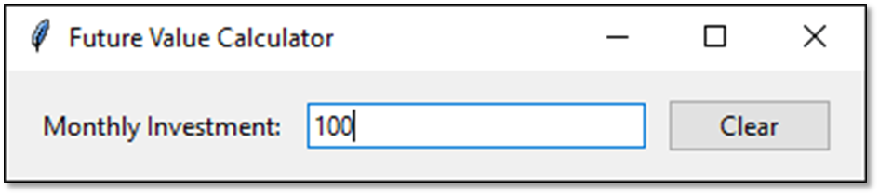
A window that contains a frame

Slide 20
A class that defines a frame (part 1)
import tkinter as tk
from tkinter import ttk
class InvestmentFrame(ttk.Frame):
def __init__(self, parent):
ttk.Frame.__init__(self, parent, padding="10 10 10 10")
self.pack(fill=tk.BOTH, expand=True)
# Define string variable for the entry field
self.monthlyInvestment = tk.StringVar()
# Create a label, an entry field, and a button
ttk.Label(self, text="Monthly Investment:").grid(
column=0, row=0, sticky=tk.E)
ttk.Entry(self, width=25,
textvariable=self.monthlyInvestment).grid(
column=1, row=0)
ttk.Button(self, text="Clear", command=self.clear).grid(
column=2, row=0)

Slide 21
A class that defines a frame (part 2)
# Add padding to all child components
for child in self.winfo_children():
child.grid_configure(padx=5, pady=3)
# Define the callback method for the Clear button
def clear(self):
print("Monthly Investment:",
self.monthlyInvestment.get())
self.monthlyInvestment.set("")
if __name__ == "__main__":
root = tk.Tk() # Create the root window
root.title("Future Value Calculator")
InvestmentFrame(root) # Create the frame
root.mainloop() # Display the frame

Slide 22
The GUI for the Future Value Calculator

Slide 23
The business module
class Investment():
def __init__(self):
self.monthlyInvestment = 0
self.yearlyInterestRate = 0
self.years = 0
def calculateFutureValue(self):
monthlyInterestRate = self.yearlyInterestRate / 12 / 100
months = self.years * 12
futureValue = 0
for i in range(months):
futureValue += self.monthlyInvestment
monthlyInterestAmount = futureValue *
monthlyInterestRate
futureValue += monthlyInterestAmount
return futureValue

Slide 24
The ui module (part 1)
import tkinter as tk
from tkinter import ttk
import locale
from business import Investment
class FutureValueFrame(ttk.Frame):
def __init__(self, parent):
ttk.Frame.__init__(self, parent, padding="10 10 10 10")
self.parent = parent
self.investment = Investment()
result = locale.setlocale(locale.LC_ALL, '')
if result == 'C' or result.startswith('C/'):
locale.setlocale(locale.LC_ALL, 'en_US')
# Define string variables for text entry fields
self.monthlyInvestment = tk.StringVar()
self.yearlyInterestRate = tk.StringVar()
self.years = tk.StringVar()
self.futureValue = tk.StringVar()
self.initComponents()

Slide 25
The ui module (part 2)
def initComponents(self):
self.pack()
ttk.Label(self, text="Monthly Investment:").grid(
column=0, row=0, sticky=tk.E)
ttk.Entry(self, width=25,
textvariable=self.monthlyInvestment).grid(
column=1, row=0)
ttk.Label(self, text="Yearly Interest Rate:").grid(
column=0, row=1, sticky=tk.E)
ttk.Entry(self, width=25,
textvariable=self.yearlyInterestRate).grid(
column=1, row=1)
ttk.Label(self, text="Years:").grid(
column=0, row=2, sticky=tk.E)
ttk.Entry(self, width=25, textvariable=self.years).grid(
column=1, row=2)

Slide 26
The ui module (part 3)
ttk.Label(self, text="Future Value:").grid(
column=0, row=3, sticky=tk.E)
ttk.Entry(self, width=25, textvariable=self.futureValue,
state="readonly").grid(column=1, row=3)
self.makeButtons()
for child in self.winfo_children():
child.grid_configure(padx=5, pady=3)
def makeButtons(self):
# Create a frame to store the two buttons
buttonFrame = ttk.Frame(self)
buttonFrame.grid(column=0, row=4, columnspan=2, sticky=tk.E)
ttk.Button(buttonFrame, text="Calculate",
command=self.calculate).grid(column=0, row=0,
padx=5)
ttk.Button(buttonFrame, text="Exit",
command=self.parent.destroy).grid(column=1, row=0)

Slide 27
The ui module (part 4)
def calculate(self):
self.investment.monthlyInvestment = float(
self.monthlyInvestment.get())
self.investment.yearlyInterestRate = float(
self.yearlyInterestRate.get())
self.investment.years = int(self.years.get())
self.futureValue.set(locale.currency(
self.investment.calculateFutureValue(), grouping=True))
if __name__ == "__main__":
root = tk.Tk()
root.title("Future Value Calculator")
FutureValueFrame(root)
root.mainloop()

